Slide 1
Haptic Feedback with nitinol
Ben Wickenden

Slide 2
Overview
The project is focused around providing Haptic feedback in the form of a glove. The feedback is provided by the use of vibration motors and a shape memory alloy, called Nitinol.
I will also be creating a simulation in Unity to demonstrate the Haptic glove. This will be done by creating and animating a model hand in Blender which will then be controlled by scripts in Unity. Unity then sends a string to an Arduino which then triggers the relevant feedback

Slide 3
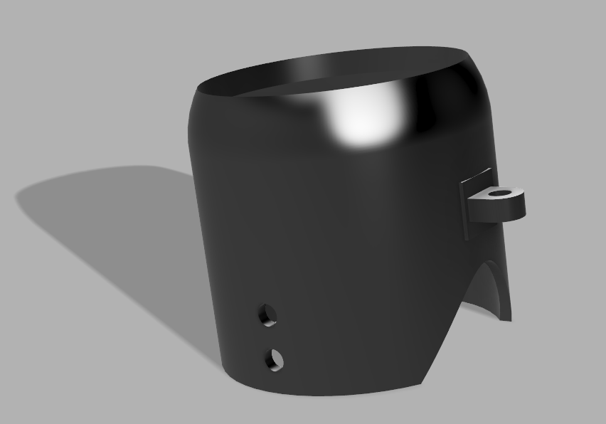
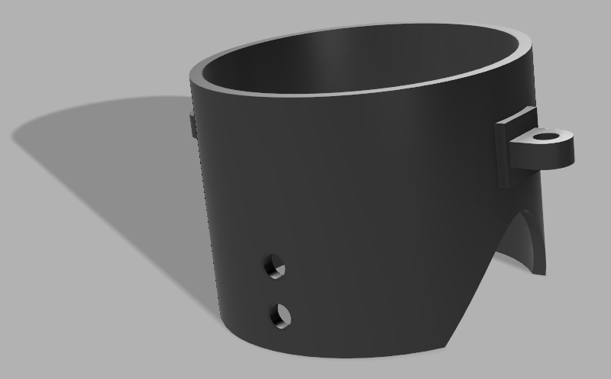
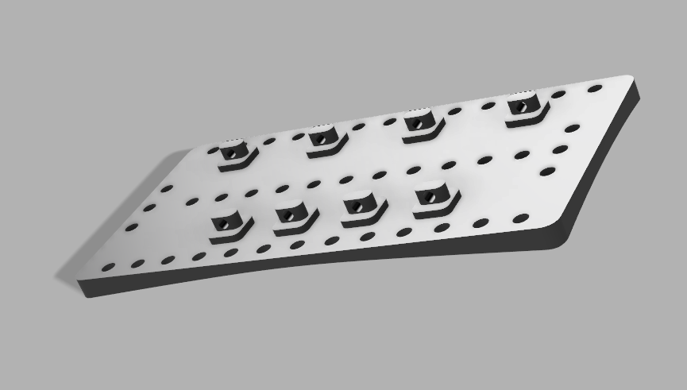
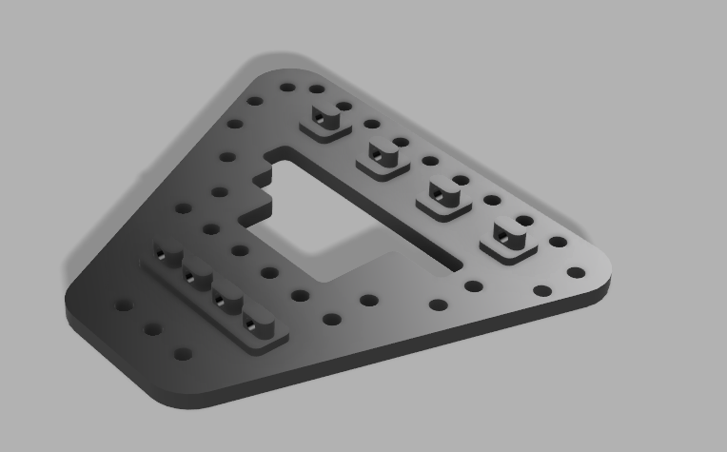
Hardware
The main focus around the project is the use of Nitinol wire to produce a force to be used as a form of Haptic feedback, with the additional use of vibration motors
I’ve chosen to use a wire with the diameter of 150μm, with an activation temperature of 90°C which has the pull force of 300g and off time of 1.2 seconds

Slide 4
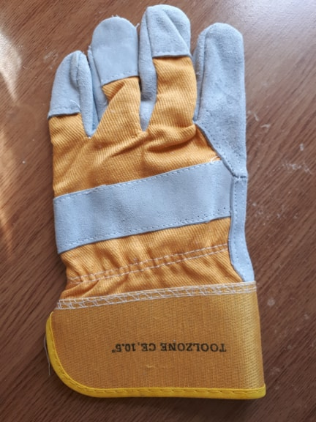
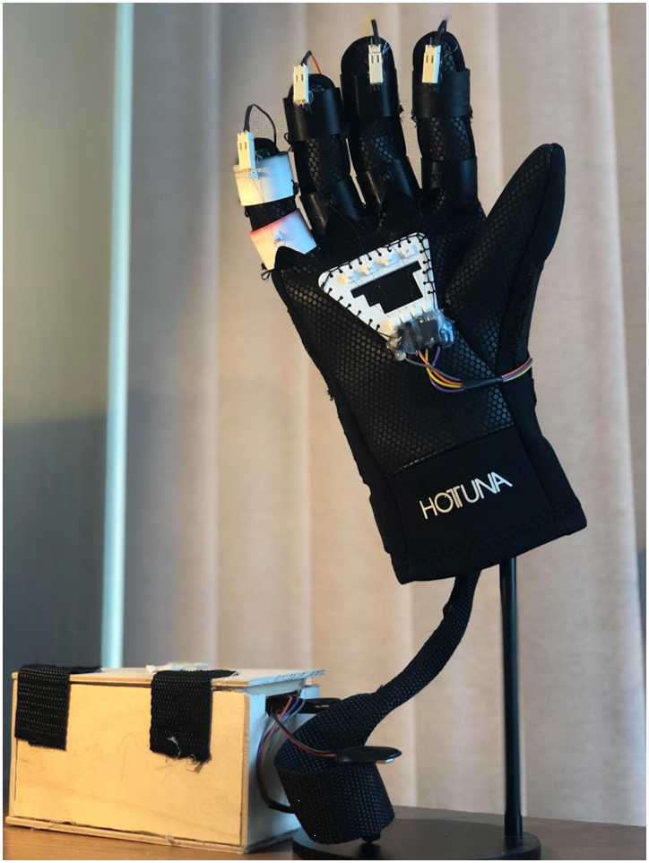
Glove design
The glove itself was originally a thick workers glove that would have an exoskeleton, Which the Nitinol Wire would be attached to.
I decided to change the design as I found the glove to be too thick and uncomfortable for the user.
I replaced the workers glove with a wet suit glove which was more flexible and had a better look to it overall.

Slide 5
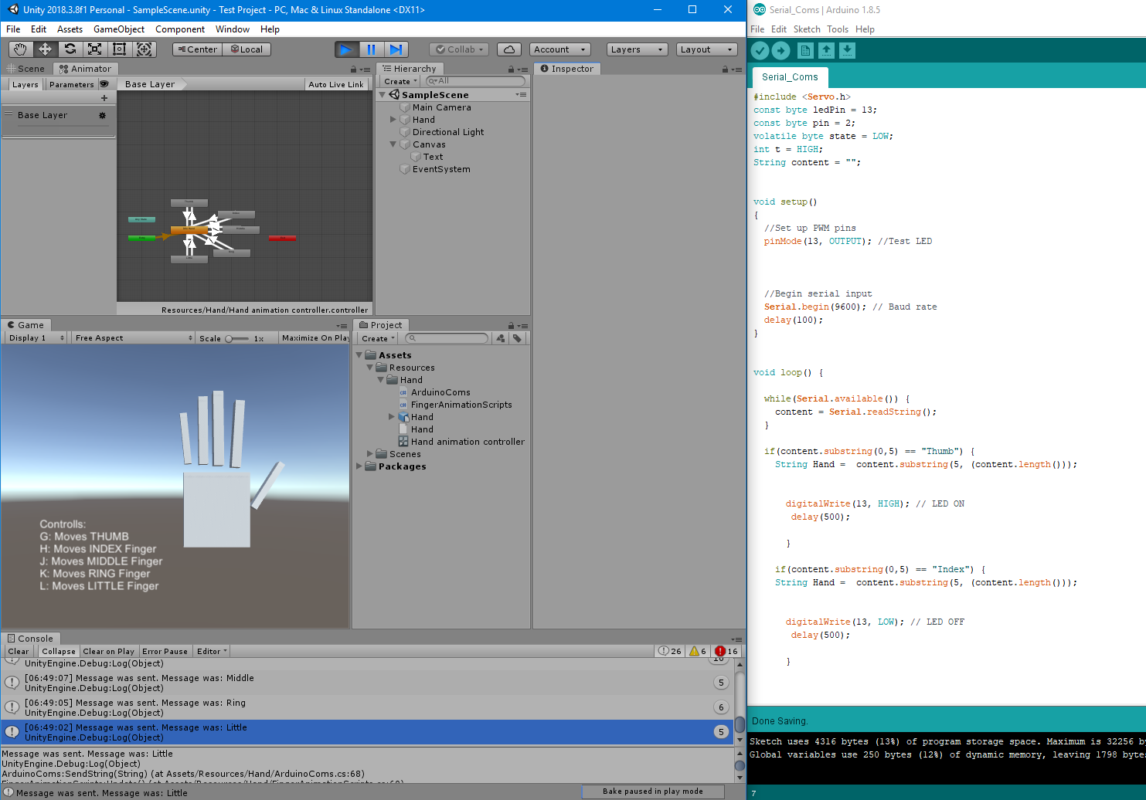
Software
Blender: Create a model hand to be used in Unity. I used Blender to give the hand a skeleton, which was then used to animate the model
Unity: This software is used to create the simulations, I’ve used the hand model, alongside scripts written in C# to allows the user to control the fingers.(and thumb).
Arduino: When a key is pressed Unity sends a string to the Arduino which then reads the string and uses the data to complete a task.

Slide 6
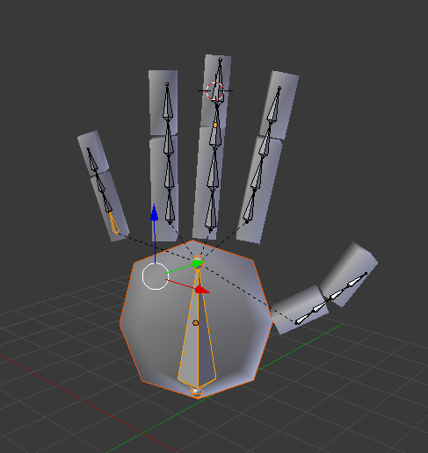
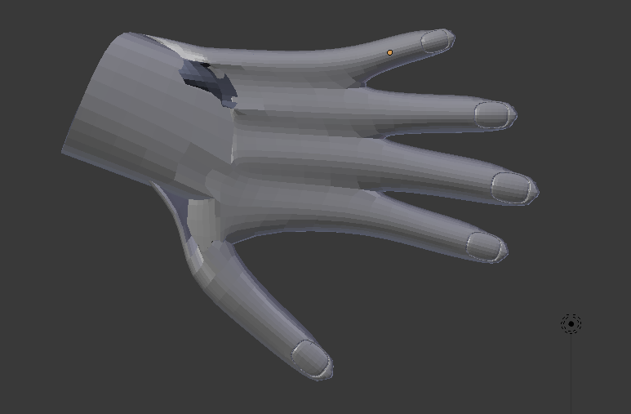
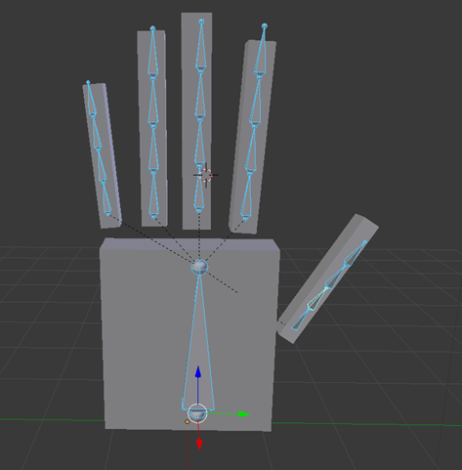
Hand Models
I’ve tried several different approaches to making hand models in Blender
I decided to choose functionality over design, so created a simplified hand model to be used instead

Slide 7
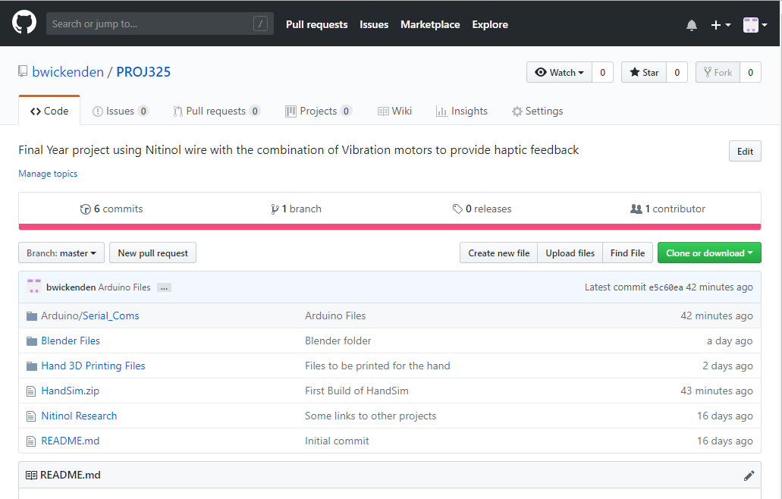
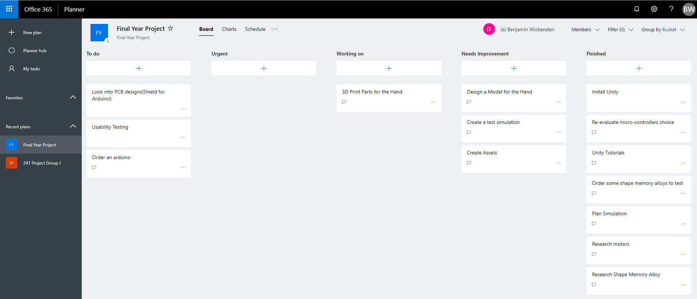
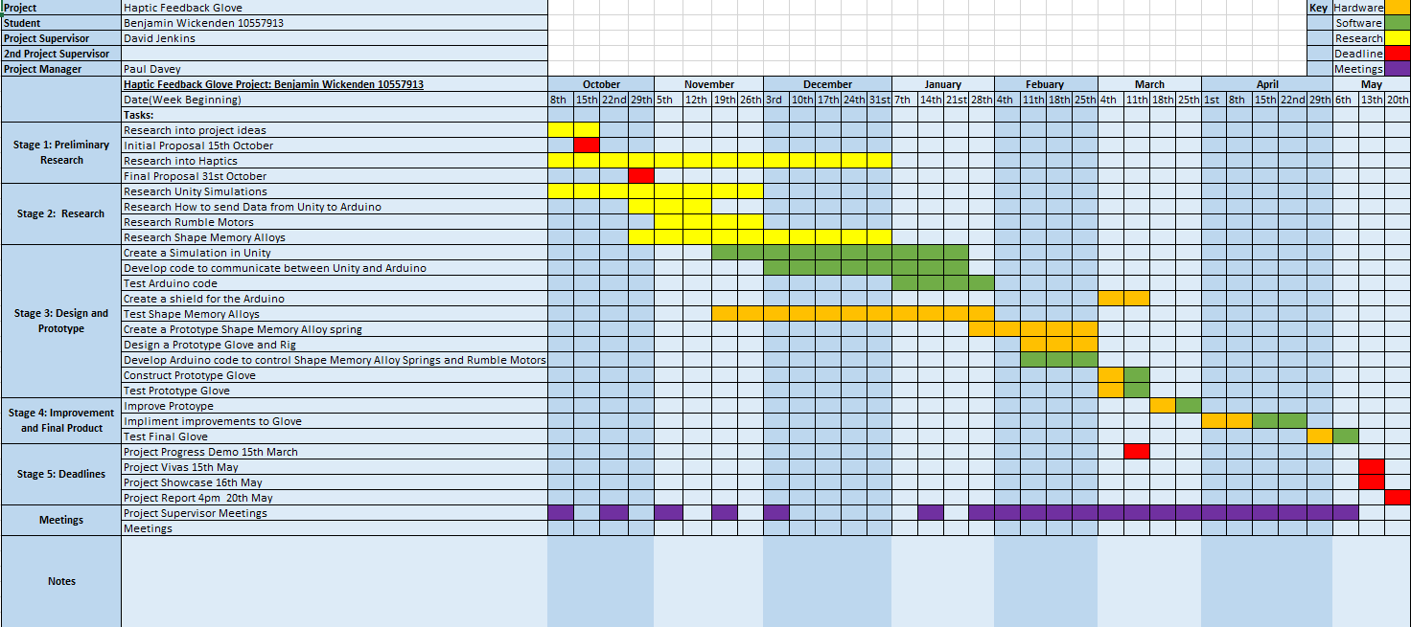
Management
For organisation I’ve used the following:
Microsoft Planner: For collecting my notes and setting tasks
GitHub: For storing my work and version control
Gantt Chart: Forecast work (Updated twice)
Paper Journal: Keeping day to day notes

Slide 8
Improvements
Use longer wires going to the box so then it can be mounted to a belt
Better visuals for Unity
More animations from Blender
Set the current limit higher to allow for more leeway
Better method for attaching Nitinol
Use Thicker Nitinol wire : https://www.robotshop.com/media/files/PDF/flexinol-technical-data.pdf

Slide 9
What I could have done differently
STM Board- with Mbed to use threads
Use Rumble Motors
Use a power supply for the Nitinol on the glove
Create Nitinol Springs
3D Print a box for the Arduino and circuit
Use a voltage Regulator Circuit

Slide 10
Going Forwards
The Glove has a reasonable amount of potential. There are several application that it could be used for in the future:
Haptic Gaming glove
Physiotherapy
Prosthetic hand
Training

